Slide 1
Research Center for Earth Operative Monitoring (NTs OMZ)
Established in 1999
Operator of Russian Earth observation satellites

Slide 2
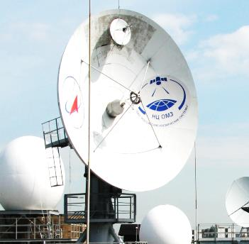
Main activities
Orbital constellation
Ground infrastructure
Exploitation of ETRIS DZZ system
Data reception
Data processing
Data quality control
Data storage
Satellite acquisitions planning
Participation in satellites tasking
Main customers –
State Space Corporation “Roscosmos” and space organizations
Science and technologies
Information sources
Systematic and applied research
Development of ground EO infrastructure segments
Analytics/consulting
Federal data fund
Geoportal of State Space Corporation “Roscosmos”

Slide 3
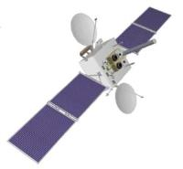
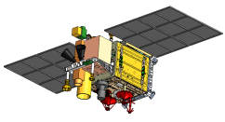
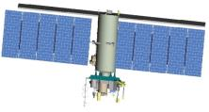
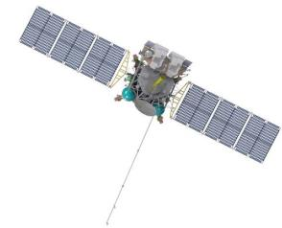
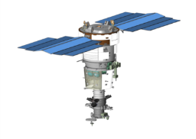
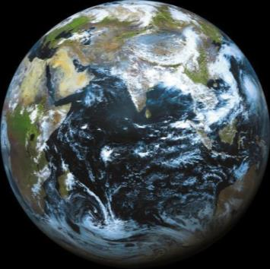
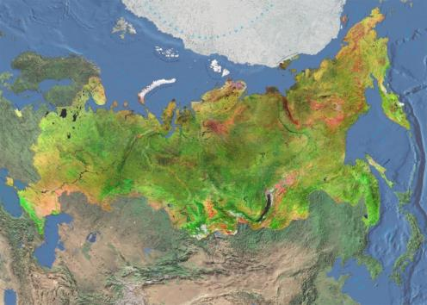
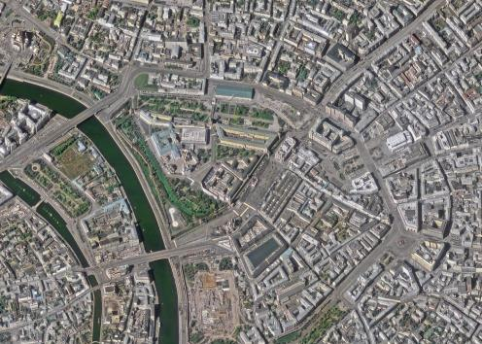
Space monitoring
Electro-L
Meteor-M
Kanopus-V
Arktika-M
Resurs-P
Meteor-M
Resurs-P
Kanopus-V-IK
GLOBAL
REGIONAL
LOCAL
Hydrometeorological observation
Low resolution (lower than 1 000 m) – free access
Acquisition – each 30 minutes
Environmental and resource monitoring
Disasters management
High and medium resolution (15 – 1 000 m) – free access
Daily revisit period
Infrastructure monitoring
mapping
Detailed and high resolution (0.7 – 15 m) – free access for governmental authorities
Daily revisit period

Slide 4
RESURS-P and KANOPUS-V
PURPOSE
Acquisition of high resolution EO data in visible and IR spectra for environment monitoring, natural resources inventory, raw materials search, large-scale mapping.
RESURS-P, SENSORS
Optical electronic VHR sensor [Geoton]
Panchromatic resolution
(0.60-0.72 μm) – 0.9 m
Multispectral resolution
(5 bands, 0.45-0.90 μm) – 3 m
Swath width – 38 km
Wide-band multispectral HR sensor [ShMSA-VR]
Panchromatic resolution
(0.58-0.80 μm) – 12 m
Multispectral resolution
(5 bands, 0.43-0.90 μm) – 23.8 m
Swath width – 97 km
1 satellite, orbit time – 94.07 min, AOI revisit period – 3 days
Wide-band multispectral MR sensor [ShMSA-SR]
Panchromatic resolution
(0.58-0.80 μm) – 60 m
Multispectral resolution
(5 bands, 0.43-0.90 μm) – 120 m
Swath width – 441 km
Hyperspectral sensor [GSA]
Resolution (up to 255 bands, 0.4-0.9 μm) – 30 m
Swath width – 25 km
KANOPUS-V, SENSORS
Panchromatic acquisition system [PSS]
Resolution (0.54-0.86 μm) – 2.1 m
Swath width – 23 km
Multispectral acquisition system [MSS]
Resolution (4 bands, 0.46-0.84 μm) – 12 m
Swath width – 20 km
5 satellites, orbit time – 94,74 мин
AOI revisit period – 1-2 days due to the amount of constellation satellites
Multi-zone IR scanner [MSU-IK-SRM] – Kanopus-V-IK
Resolution (2 bands: 3.5-4.5, 8.4-9.4 μm) – 200 m
Swath width – 2,000 km
Noise equivalent of measured temperatures difference at 300 K – 0.1-0.2 К
Minimum size of detectable fire spot – 5×5 m

Slide 5
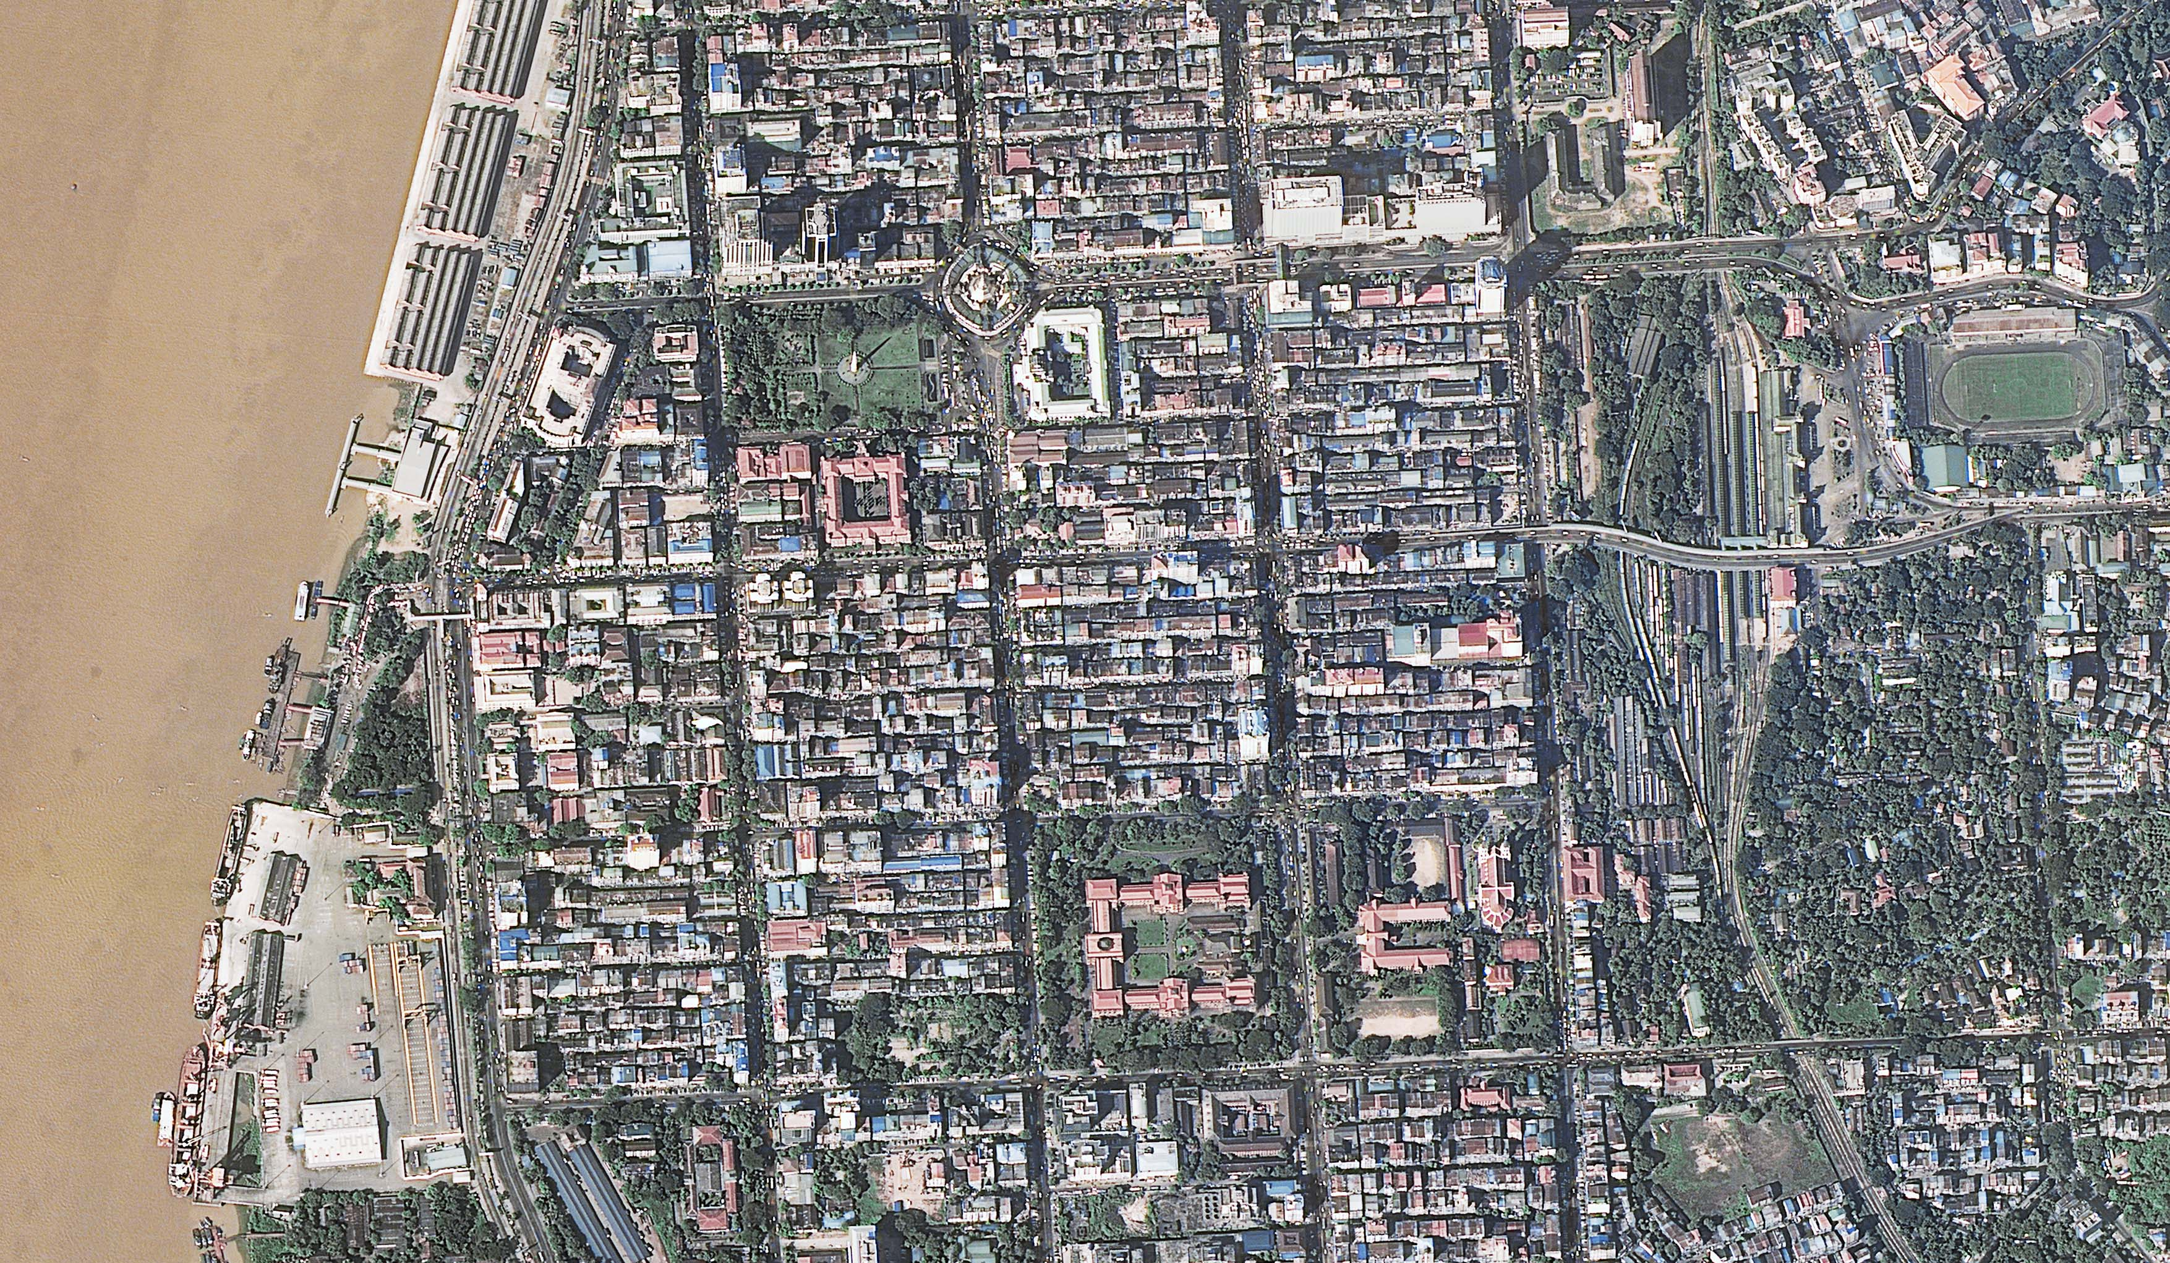
RESURS-P

Slide 6
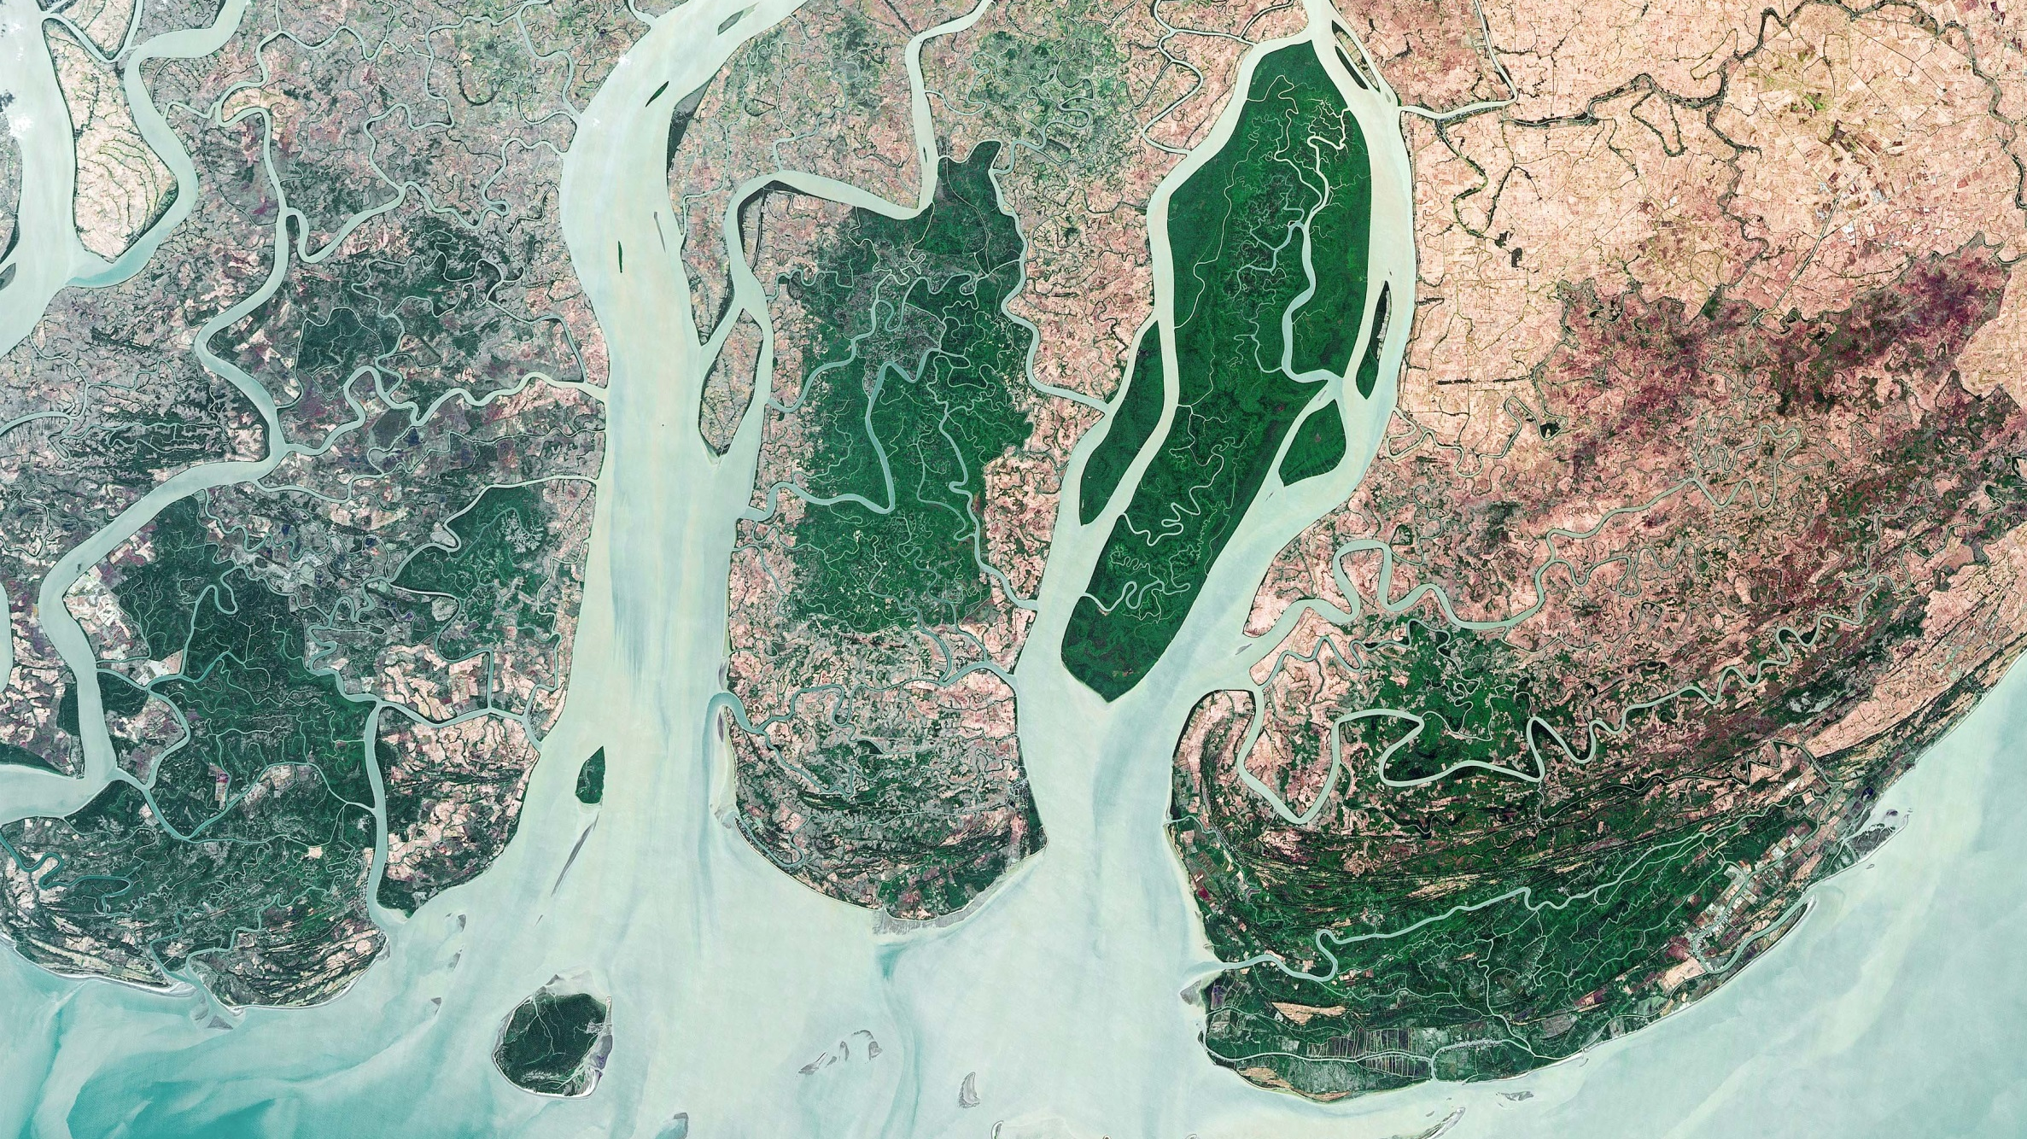
RESURS-P

Slide 7
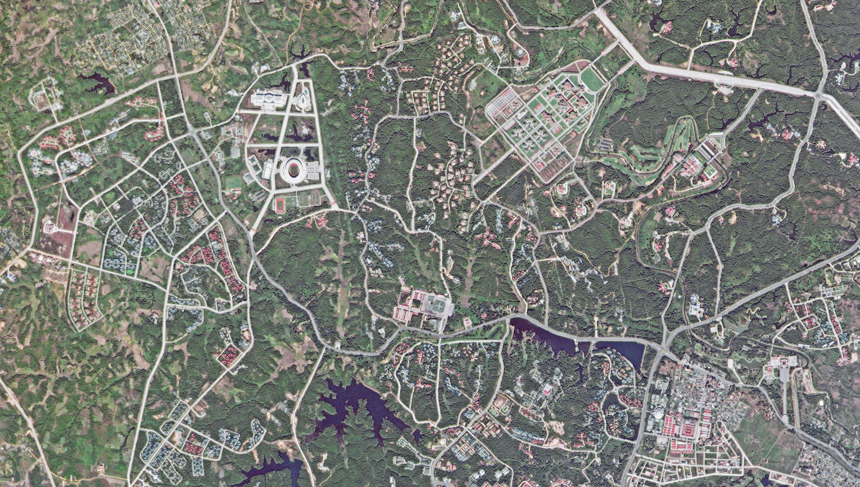
KANOPUS-V

Slide 8
METEOR-М, ELECTRO-L, ARKTIKA-M
PURPOSE
Operative data acquisition on cloud coverage and underlying surface condition, hydrometeorological data acquisition and measurements, helio-physical research, environmental monitoring, Arctic region monitoring
METEOR-M, SENSORS
Multi-zone satellite acquisition complex [KMSS]
Multi-zone scanner [MSU-100]
Multispectral resolution
(3 bands, 0.53-0.90 μm) – 60 m
Swath width – 900 km
Multi-zone scanner [MSU-50]
Multispectral resolution
(3 bands, 0.37-0.69 μm) – 120 m
Swath width – 900 km
Multi-zone LR scanner [MSU-MR]
Multispectral resolution
(6 bands, 0.5-12.5 μm) – 1000 m
Swath width – 2800 km
3 satellites, revisit period:
MSU – entire Earth’s surface twice a day;
KMSS – covers AOI once per 3 days
Helio-physical hardware complex
[GGAK]
ELECTRO-L, SENSORS
Multi-zone scanner [MSU-GS]
Covered territory – visible Earth disk
Resolution in visible specter (3 bands: 0.46–0.90 μm) – 1000 m
Near-IR resolution (7 bands: 3.5-12.5 μm) – 4000 m
2 satellites, revisit period – 30 min (standard)
– 15 min (upon request)
ARKTIKA-M, SENSORS
Multi-zone scanner [MSU-GS]
Covered territory – Arctic region
Resolution in visible specter (3 bands: 0.50-0.90 μm) – 1000 m
Near-IR resolution (7 bands: 3.5-12.5 μm) – 4000 m
1 satellite, revisit period – 30 min (standard)
– 15 min (upon request)

Slide 9
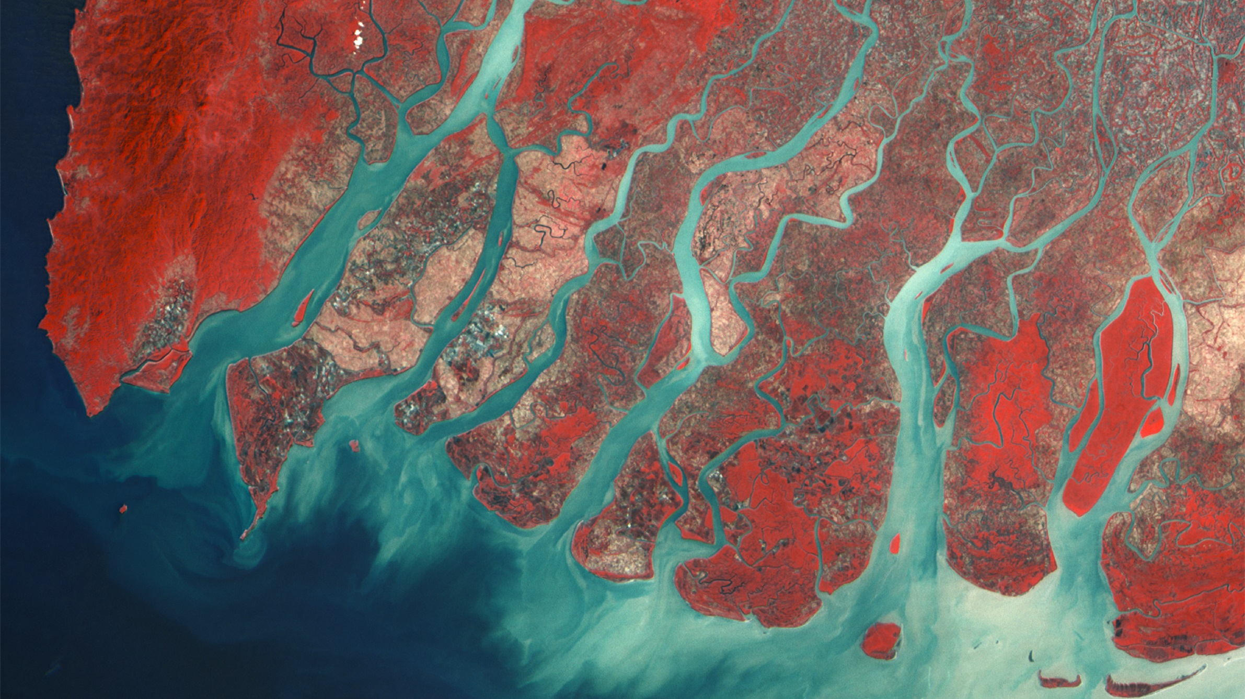
METEOR-M

Slide 10
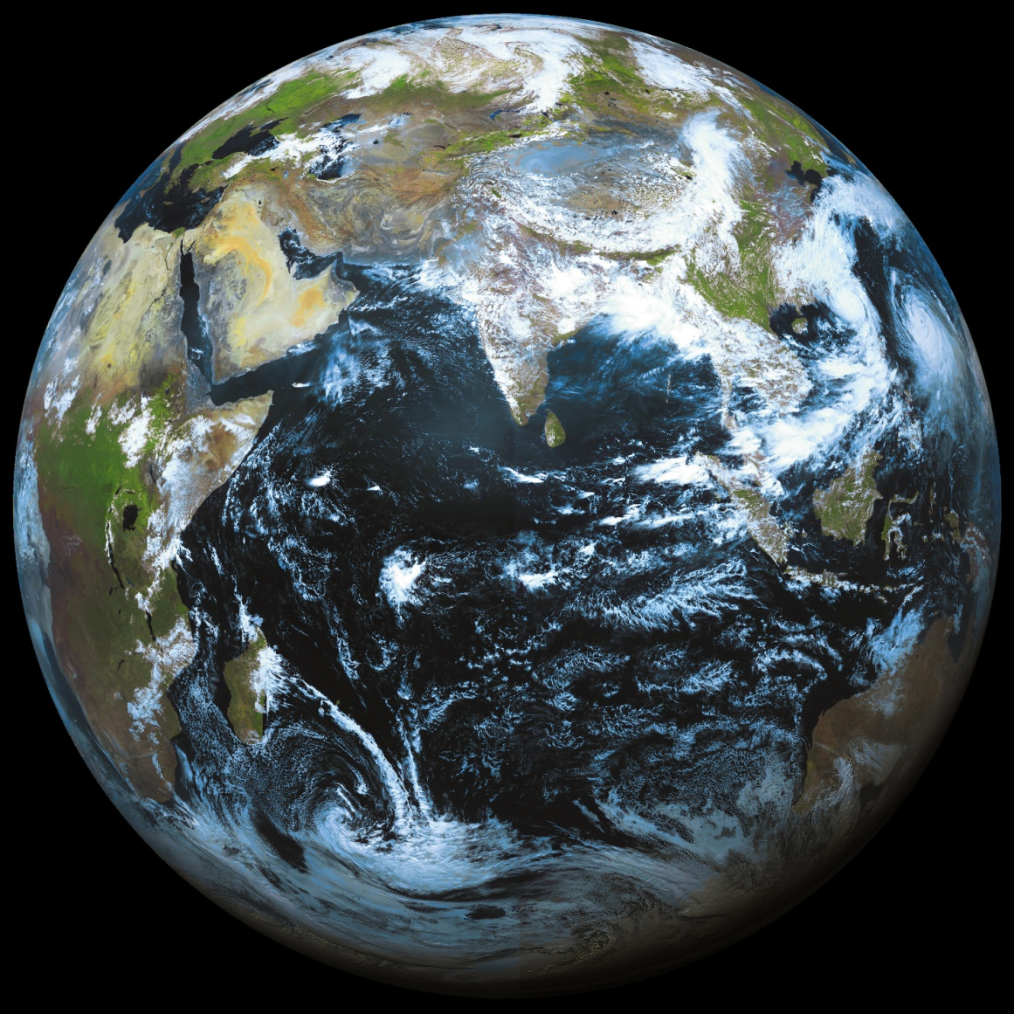
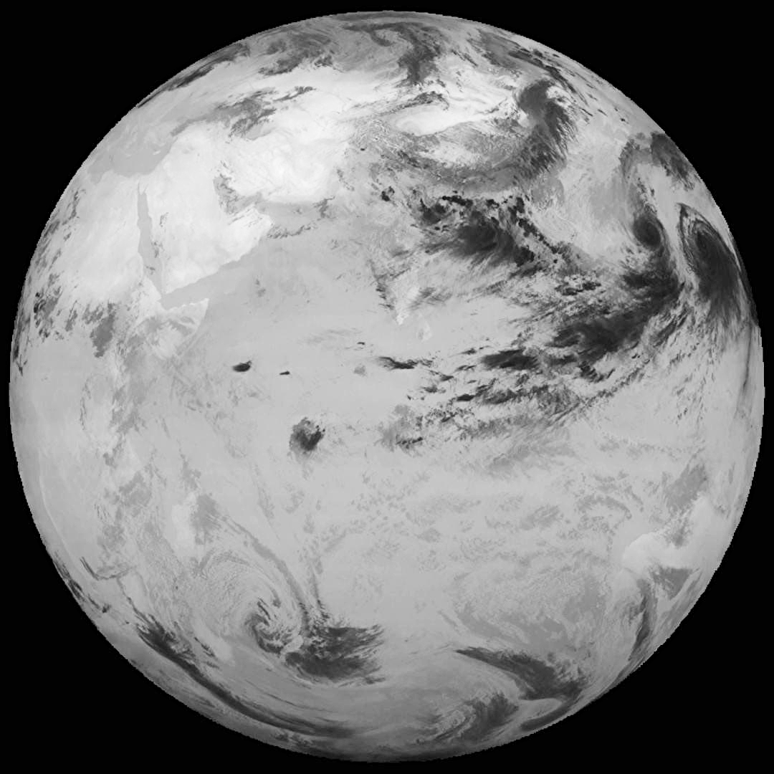
ELECTRO-L
Visible bands (RGB)
IR band (10,2-11,2µm)

Slide 11
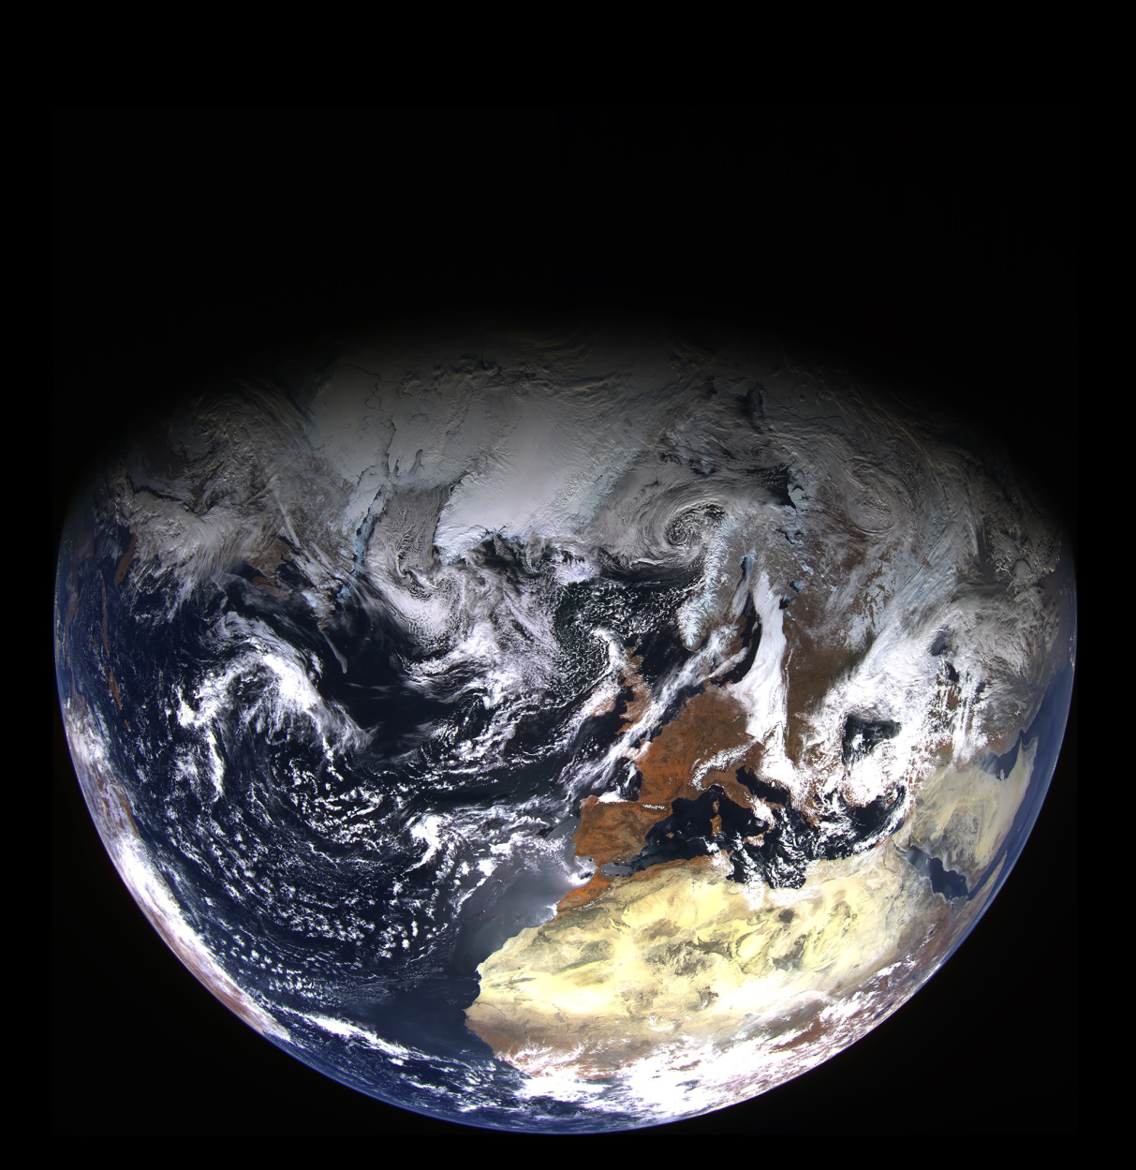
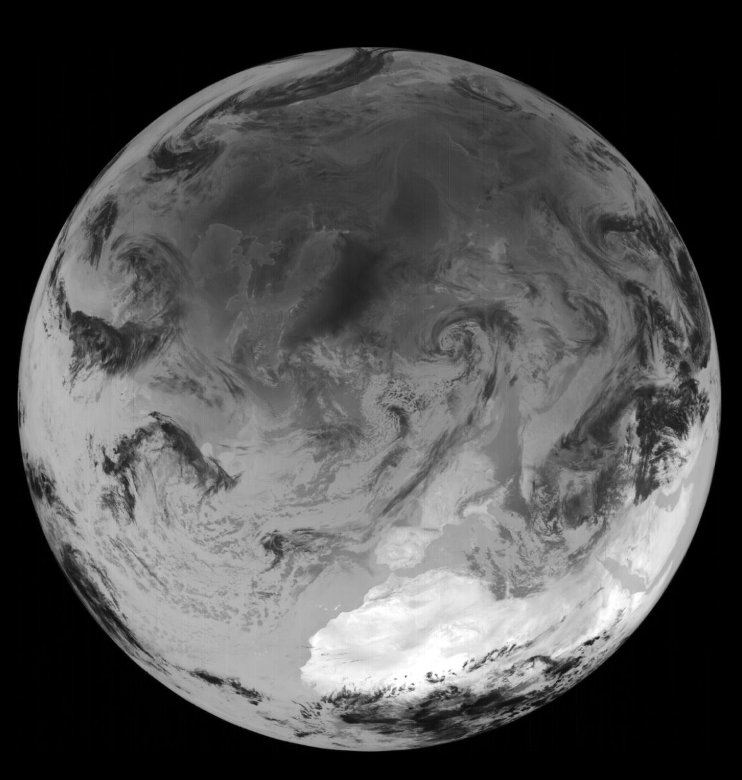
ARKTIKA-M
Visible bands (RGB)
IR band (10,2-11,2µm)

Slide 12
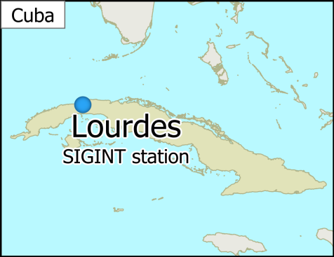
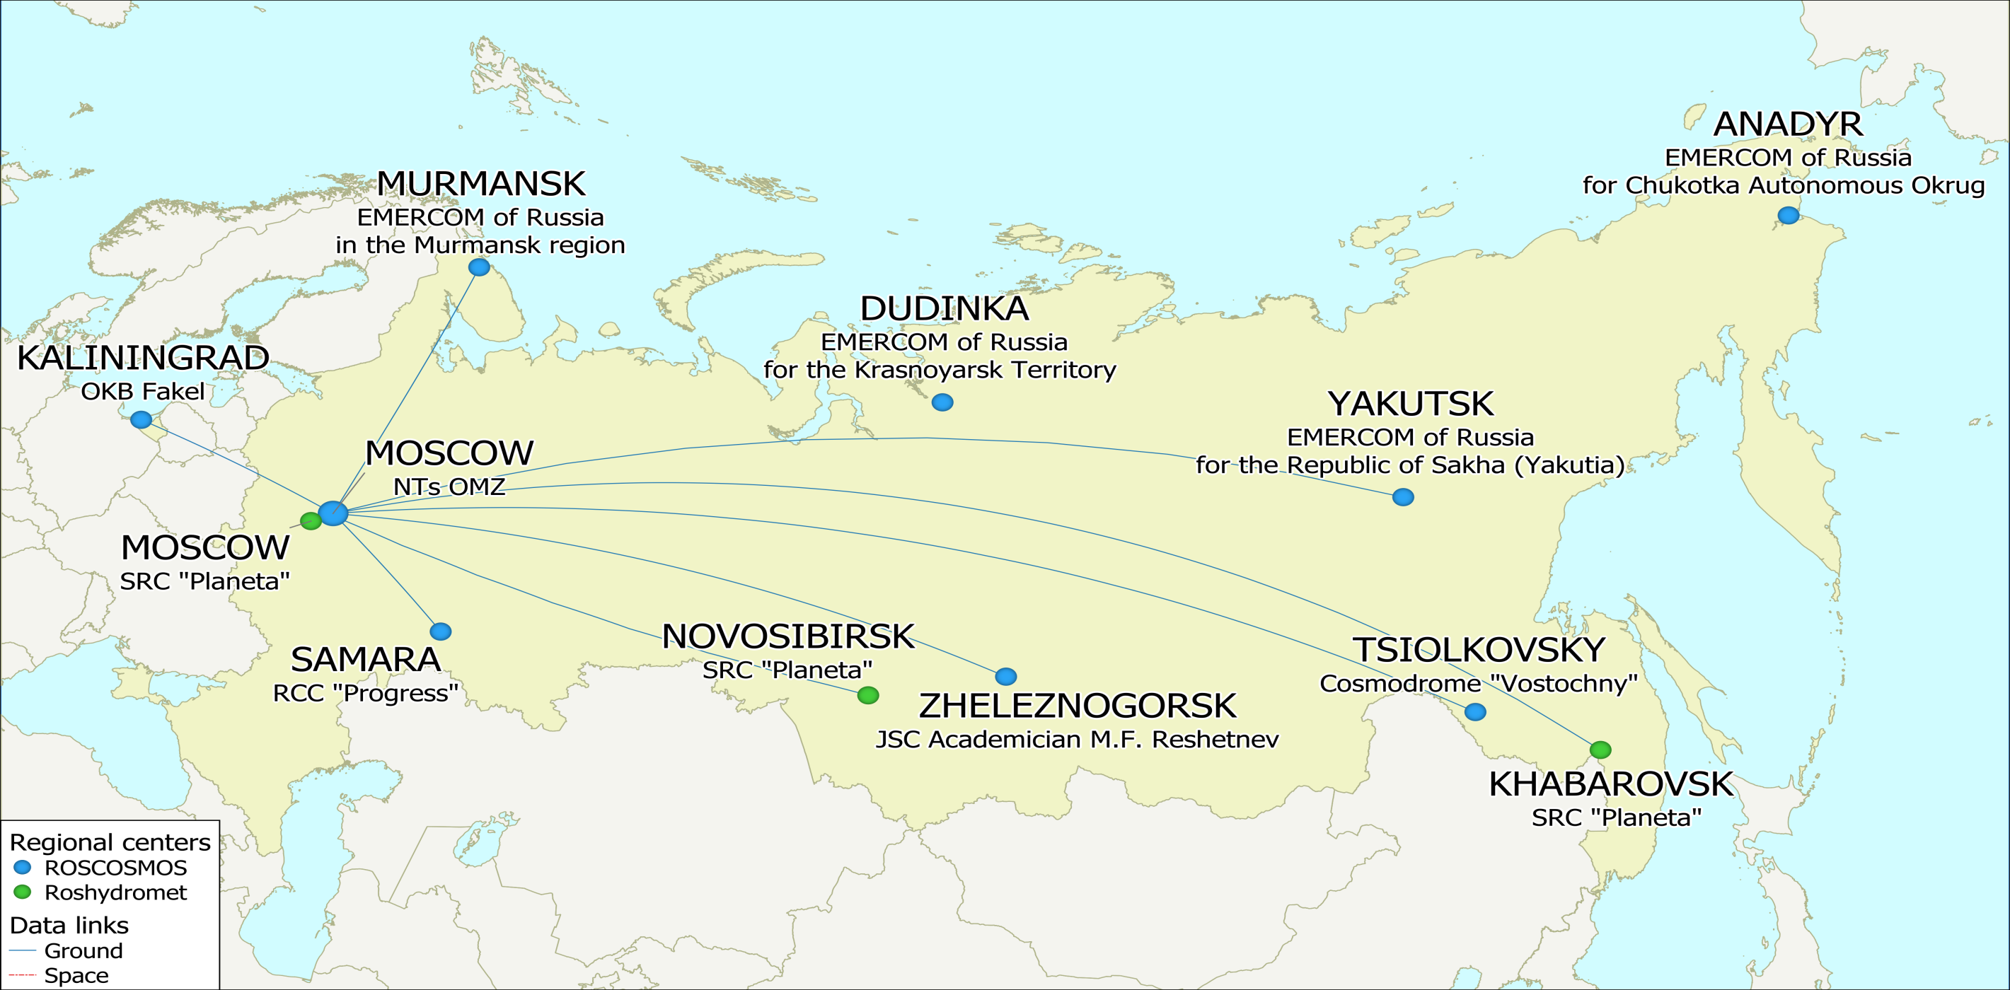
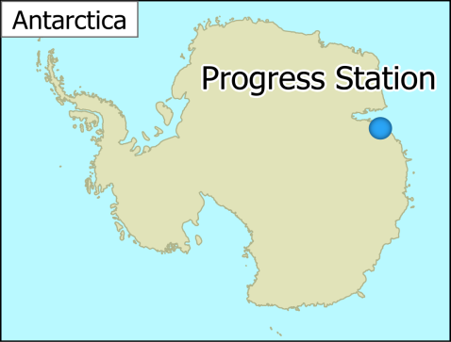
Ground EO infrastructure
More than 300 specialists working 24/7
16 data reception centers (11 – Roscosmos, 5 – Roshydromet)
64 antenna complexes (43 – Roscosmos, 21 – Roshydromet)

Slide 13
Main stages of EO data processing in NTs OMZ
данных
Radiometric correction
Geometric correction
Atmospheric correction
Quality control
Insertion into databank
Publishing on portal
*APOI– automated stream processing of information
APOI*
данных
Databank
EO satellite information
Geoportal
API
Services
Acquisition tasking
Data order from EO data state fund
Acquisition data
Data from EO data state fund
Federal and regional authorities
Physical entities
Legal entities

Slide 14
Thank you for your attention!
Research Center for Earth Operative Monitoring (NTs OMZ)
Official website: www.ntsomz.ru

